Slide 1



Microeconomic Analysis for Business Decisions: oVertone Haircare
By: Kayli W. Hill and Sarah C. Hosea
ECON300
Notes:
SARAH: Hello. We are Sarah Hosea and Kayli Hill AKA team 3. We will be analyzing oVertone Haircare and using what we have learned in this class to make suggestions for how they can improve their business decisions.

Slide 2



Your Presenters
Kayli Hill
Sarah Hosea
Notes:
KAYLI: Before we address our questions and make suggestions for oVertone Haircare, we first want to introduce ourselves. Hello, my name is Kayli Hill and I am a member of Team 3. Presenting with me is my partner, Sarah Hosea. Together we will be presenting our analysis and suggestions for oVertone Haircare.

Slide 3



Who oVertone Haircare is…
Launched in 2014
Mission: to create a product line that promotes healthy, pigmented hair without the damage of traditional dyes
Expanding offerings
Notes:
SARAH: We chose to focus our group project on oVertone Haircare, a company launched in 2014 by Maegan Scarlett and Liora Dudar. They exploited a gap in the market by creating a product that helps deposit and maintain fantasy hair color that is extremely pigmented while at the same time healthy and non-damaging for the hair. Nothing like this product existed previously in the market and oVertone revolutionized the hair color industry. This semi-permanent coloring conditioner is an alternative to traditional hair dyes and the associated toxic ingredients and damage that many people who color their hair are accustomed to.

Slide 4

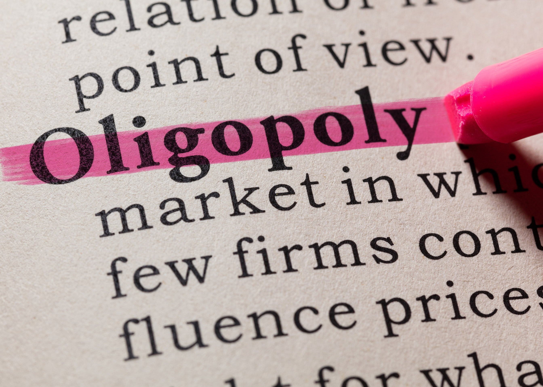
What market structure applies to oVertone Haircare?
What is an oligopoly with differentiated goods?
Few firms with a large market share
Firms do not produce identical products
High barriers to entry
Prices higher than those in perfectly competitive markets
Does oVertone fit these characteristics?
Yes!
Notes:
KAYLI: To identify oVertone’s market structure, our first step was to look at the key characteristics of each of the various market structures and substructures. We then identified which characteristics most aligned with oVertone Haircare’s business infrastructure and practices. The company is in a market with few other firms; each carrying a large market share. Although other companies have begun to produce products similar to oVertone’s, no one produces an identical product. The firm is also in a market with high barriers to entry. The most prevalent being brand loyalty. This means that it is difficult for new entrants to build a presence in the market and attract customers away from oVertone. Lastly, the prices that the few firms charge are set simultaneously and are higher than typical prices found in perfectly competitive markets. Based on this analysis, we have determined that oVertone is an oligopoly with differentiated goods.

Slide 5
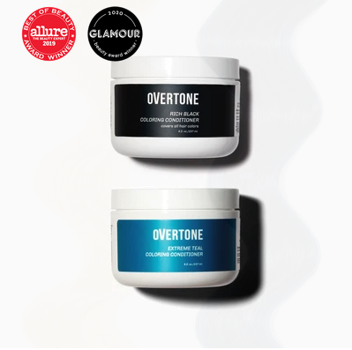
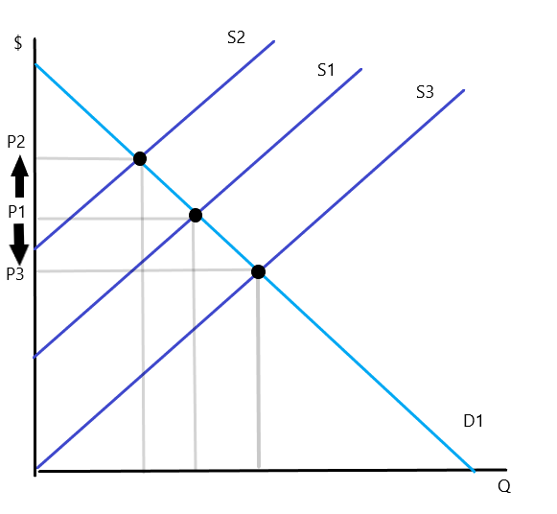
How do oVertone’s competitors react to price changes?
Products:
Conditioner kits
Clarifying shampoo
Toning conditioners
Prices:
Higher Prices
In oligopoly
  if prices go up, the competitors will probably not follow
  if prices go down, competitors will likely follow
Notes:
SARAH: Analyzing the range of oVertone’s most popular products and identifying where they are found in the industry, we were quickly able to recognize who their competitors are: dpHUE, Lime Crime, Keracolor, and Good Dye Young. Our research revealed that oVertone’s price points are in fact higher than those of most of their competitors. In a perfectly competitive market, the market itself would determine the prices; however, because oVertone is an oligopoly, it is able to determine its own prices for its products and not depend on the market. Because of how an oligopoly functions, when oVertone changes its pricing competitors may react. Traditionally, if oVertone increased prices, their competitors will probably not follow; conversely, if oVertone’s decreases their prices, their competitors are more likely to follow suit and attempt to gain some traction in market share.
The graph depicts supply curves, S1, S2, and S3 and demand curve, D1. Each intersection of the S curves at the D curve establishes an equilibrium price and equilibrium quantity and shows what happens when prices increase or decrease.

Slide 6
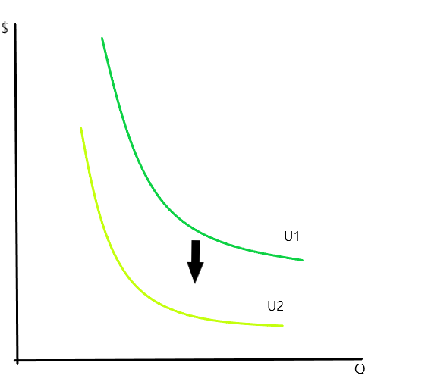
How does the substitution effect impact pricing strategies for oVertone?
Perfect substitutes are easily traded for a competitor.
Indifference curve steepness demonstrates marginal rate of substitution.
Customer Segmentation:
Customer Characteristics
  Demographics
Past Purchase Behavior
  Psychographics and historical activities
Location
  Geographics
Overtime
  Buy now or wait for better price
Good O
Good A
Figure 2
Notes:
KAYLI: Because oVertone has a unique product and loyal consumers, its marginal rate of substitution is high. Consumers are willing to give up multiple units of Good A to gain an additional unit of oVertone (Good O.) This is demonstrated by the steepness of the indifference curves. We know that consumer preferences may be highly influenced by any changes in the variables; particularly price. Although there are competitors in the market with substitutes, they are not perfect substitutes. It is imperative that oVertone chooses their price points intuitively to maintain their consumers’ brand loyalty. As we know, substitutes are highly competitive and are easily replaced; however, we believe that oVertone can maintain its higher-than-average price points if they use customer segmentation to market to various groups effectively and continue to harness their market power.

Slide 7
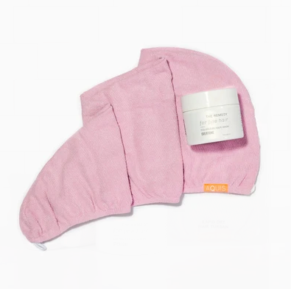
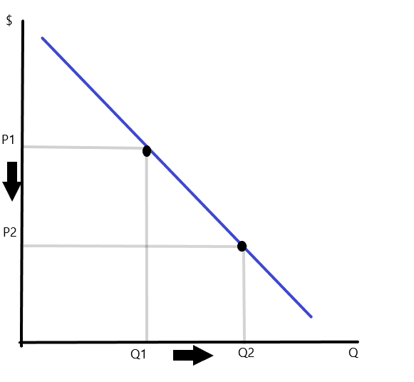
How should oVertone leverage complements and bundling to increase revenue?
Complementary goods add value
Bundling allows the purchase of several products at one price
Bundles priced lower than individual products together
Complements
Notes:
SARAH: oVertone has recently begun to dip its toe into the complementary goods pool. They currently sell only one complementary good, a super absorbent hair towel, in addition to their primary conditioners. The hair towels are sold both as stand-alone products as well as bundled with popular best-selling products. We think that oVertone has an unrealized opportunity here. We believe that the firm needs to add additional complementary goods like gloves or shower caps to their offerings. Increasing their complementary goods may prevent brand loyalists from leaving oVertone’s site to purchase products they need or want from other purveyors. Additional bundles offered at lower prices than the stand-alone products may stimulate demand and raise oVertone revenues as well.

Slide 8
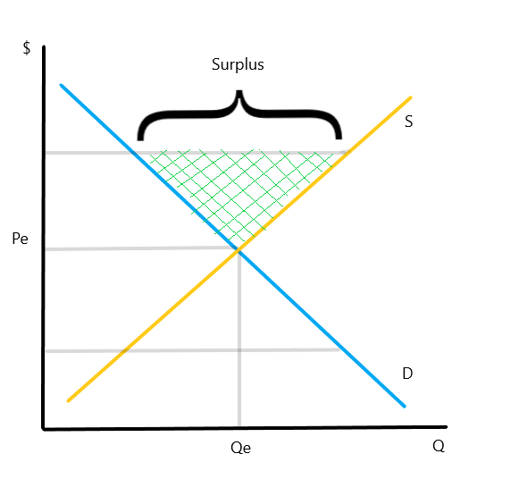
What should oVertone do with excess supply of a color conditioner?
Excess Supply
Quantity supplied > quantity demanded
Price > equilibrium price
Scrap product
Sit on stock
Notes:
KAYLI: Because of a manufacturing error, oVertone ended up with thousands of extra units of a particular color. Instead of choosing to scrap the products manufactured in error; the firm opted to purchase them for lower than the typical cost. This supply is in excess of demand for this product. When supply exceeds demand, there is a supply surplus; therefore, the price is above the equilibrium price. oVertone has too many units of this particular color and will probably not be able to offload the bottles of conditioner before they go bad. We believe that in order for oVertone to reap the most benefit they can from this mistake, they need to reduce the price of this particular product. Reducing the price will increase demand for the good until the supply once again meets said demand and equilibrium price is achieved.

Slide 9
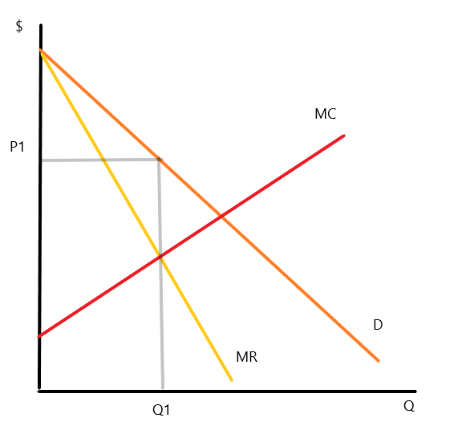
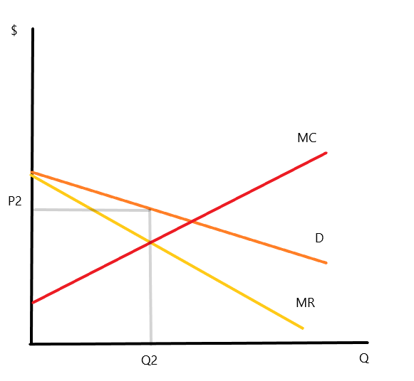
How can oVertone further exploit third-degree price discrimination?
What is it?
Company charges a different price to different consumer groups.
Conditions for use
Firm must have market power
Firm must be able to differentiate demand
Firm must be able to prevent resale
How oVertone uses it?
Professionals
Consumers
Consumers
Professionals
Notes:
SARAH: oVertone Haircare currently uses third-degree price discrimination by charging different prices to a couple consumer groups. They have different pricing structures for professionals (e.g., cosmetologists and hair stylists) and consumers (e.g., the general public.) Professionals are charged a lower price than consumers and typically buy in bulk. The theory behind charging lower prices to professionals is that they will use the products in their salons, or recommend the product for upkeep after salon services. Based on the stylist recommendations, consumers may purchase oVertone products on their own and increase the customer base. Consumers, who are the bulk of oVertone customers are crucial to the business. We believe that there is room in the pricing structure to realize additional revenue by increasing the use of third-degree price discrimination. We suggest that oVertone add two additional customer segments with their own pricing for both students and seniors. Both of those groups are typically price conscious, but could make up a large portion of new customers for the brand.

Slide 10
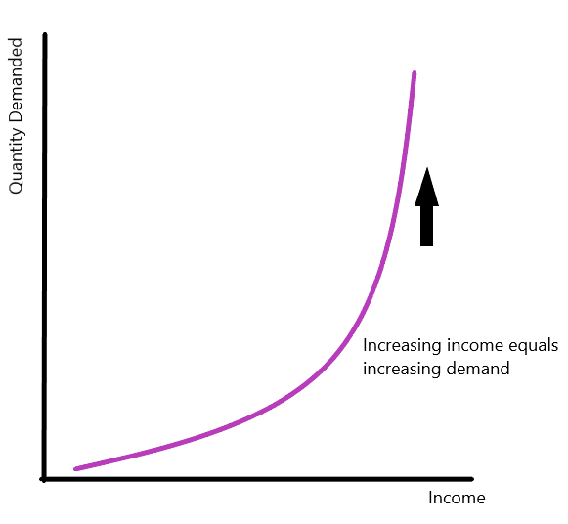
How should oVertone pursue customers who found them during the pandemic?
Economic Shock
Demand Shock
Elasticity of Demand in 2020
Relatively elastic due to pandemic
Consumer demand increased
Consumers willing to pay more
Notes:
KAYLI: Another relevant occurrence for oVertone in 2020 was the elasticity of demand of their customers. Before we discuss that we need to address economic shock and demand shock. An economic shock is an unpredictable or unexpected event that impacts the broader economy and demand shock affects aggregate demand therefore it can also affect prices. Due to the pandemic, people were at home and could not go into salons to get their hair colored. Many people turned to at-home products to meet their haircare needs. For oVertone that meant that demand was elastic and consumers were demanding significantly more of their products and would have been willing to pay more had the firm charged more. Since we know that elasticity is an economic measure of how sensitive an economic factor is to another we can see this effect reflected in the graph through changes in demand due to changes in income, although people were not actually richer, they felt richer since they had money that would normally go to other things like vacations. The income effect came into play as a response to the pandemic and influences the increase of demand. In response to the new customers flocking to oVertone, we believe they should pursue a strategy of advertising directed at maintenance of hair color. That way when consumers return to salons, they will still purchase oVertone product to maintain the color done in the salon. This could prevent oVertone from losing all of the consumers who found them during the pandemic.

Slide 11
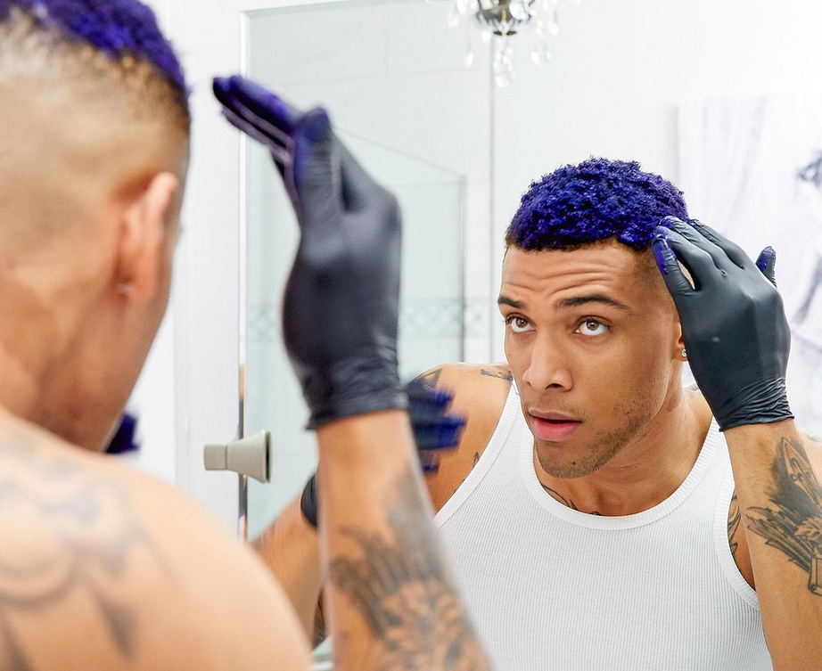
Summary
Oligopoly
Competitor response to price changes
High marginal rate of substitution
Complements and bundling
Offload excess supply
Third-degree price discrimination
Elasticity of demand – retaining customers
Notes:
SARAH: During this presentation, it was initially important for us to identify the market structure in which oVertone participates. That allowed us to pinpoint how and why it operates as it does. Once we were able to determine the particular characteristics of the firm, we could then more accurately make suggestions for oVertone that would support its growth and improvement. We believe that oVertone should maintain its identified market structure in an oligopoly, control its pricing without much influence from its competitors, add additional complementary products and sell them as both stand-alone, as well as in bundles with top sellers, reduce the price of the products with excess supply to realize revenue, expand their use of third-party differentiation, and work to retain customers who found them during the pandemic. Focusing on these suggested changes, we believe that oVertone could benefit financially and potentially increase their market share and customer base.

Slide 12
References:
Boyce, P. (2021, February 07). Complementary goods definition. Retrieved February 19, 2021, from https://boycewire.com/complementary-goods- definition/
Boyce, P. (2021, February 08). Oligopoly definition. Retrieved February 17, 2021, from https://boycewire.com/oligopoly-definition/
Boyce, P. (2021, February 13). Substitute goods definition. Retrieved February 19, 2021, from https://boycewire.com/substitute-goods-definition/
Determinants of demand: Price of complements and substitutes (video). (n.d.). Retrieved February 19, 2021, from https://www.khanacademy.org/economics-finance-domain/ap-macroeconomics/basic-economics-concepts-macro/demand/v/price- of-related-products-and-demand
Goolsbee, A., Levitt, S. D., & Syverson, C. (2016). Microeconomics (2nd ed.). New York, NY: Worth.
Makler, C. (2017). Econgraphs. Retrieved February 19, 2021, from https://www.econgraphs.org/
McKenzie, G. (2020, July 9). Modern day oligopoly - UPS and FedEx. Retrieved February 19, 2021, from https://www.lojistic.com/blog/modern-day- oligopoly-ups-and-fedex
Our story. (n.d.). Retrieved February 19, 2021, from https://overtone.co/
OVertone haircare Competitors, Revenue, alternatives and pricing. (n.d.). Retrieved February 19, 2021, from https://growjo.com/company/oVertone_Haircare
Smith, C. (2020, March 26). Supply & demand Shocks amid Coronavirus: St. Louis Fed. Retrieved February 26, 2021, from https://www.stlouisfed.org/open-vault/2020/march/supply-demand-shocks-coronavirus
Spaulding, W. C. (n.d.). Oligopoly pricing models. Retrieved February 19, 2021, from https://thismatter.com/economics/oligopoly-pricing-models.htm
Thea, F. (2017, March 23). How overtone brought an existing solution to a market that didn't know about it (yet). Retrieved February 19, 2021, from https://www.shopify.com/blog/selling-an-existing-solution

